Slide 1
Introduction to Artificial Intelligence
CSCI 3202:
The Perceptron Algorithm
Greg Grudic
Greg Grudic
Intro AI

Slide 2
Questions?
Greg Grudic
Intro AI

Slide 3
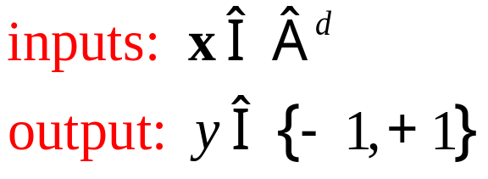
Binary Classification
A binary classifier is a mapping from a set of d inputs to a single output which can take on one of TWO values
In the most general setting
Specifying the output classes as -1 and +1 is arbitrary!
  Often done as a mathematical convenience
Greg Grudic
Intro AI

Slide 4
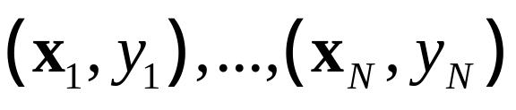

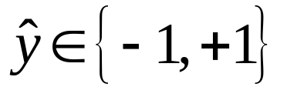
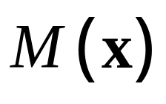
A Binary Classifier
Given learning data:
A model is constructed:
Classification
Model
Greg Grudic
Intro AI

Slide 5

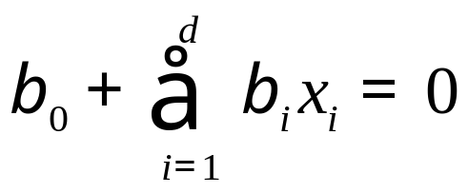
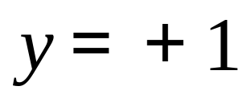
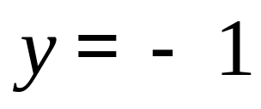
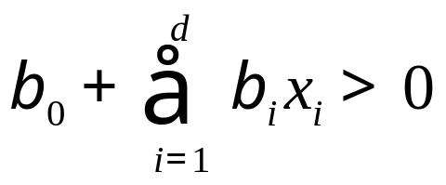
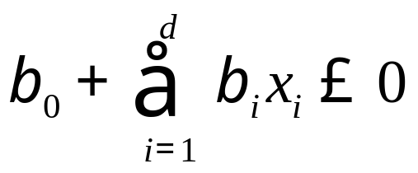

Linear Separating Hyper-Planes
Greg Grudic
Intro AI

Slide 6
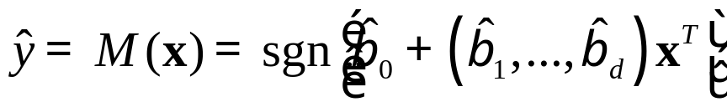
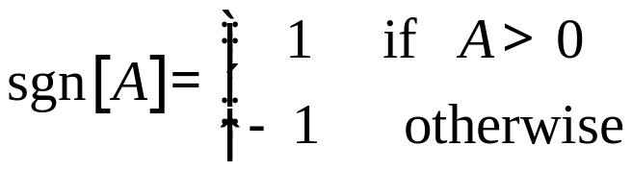
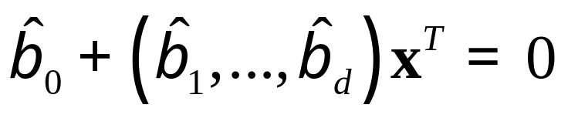
Linear Separating Hyper-Planes
The Model:
Where:
The decision boundary:
Greg Grudic
Intro AI

Slide 7
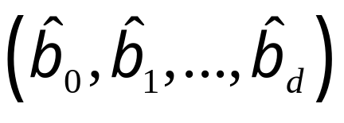
Linear Separating Hyper-Planes
The model parameters are:
The hat on the betas means that they are estimated from the data
Many different learning algorithms have been proposed for determining
Greg Grudic
Intro AI

Slide 8
Rosenblatt’s Preceptron Learning Algorithm
Dates back to the 1950’s and is the motivation behind Neural Networks
The algorithm:
  Start with a random hyperplane
  Incrementally modify the hyperplane such that points that are misclassified move closer to the correct side of the boundary
  Stop when all learning examples are correctly classified
Greg Grudic
Intro AI

Slide 9

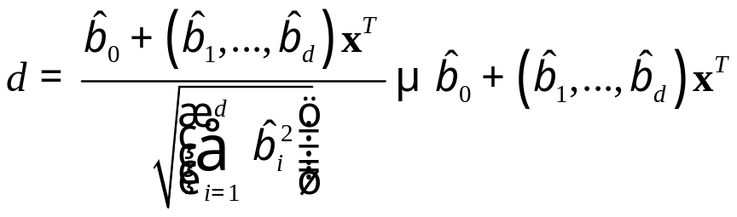

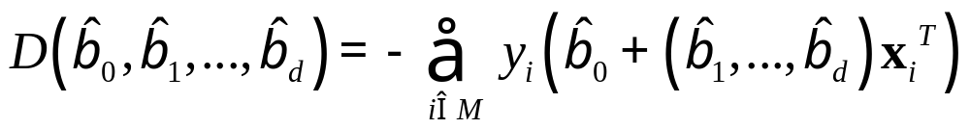
Rosenblatt’s Preceptron Learning Algorithm
The algorithm is based on the following property:
  Signed distance of any point to the boundary is:
Therefore, if is the set of misclassified learning examples, we can push them closer to the boundary by minimizing the following
Greg Grudic
Intro AI

Slide 10
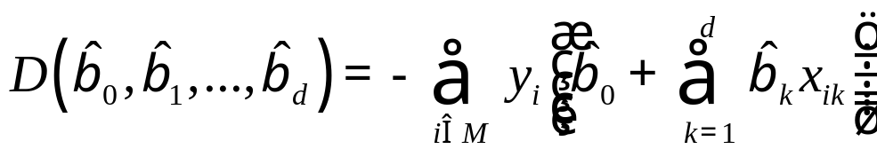
Rosenblatt’s Minimization Function
This is classic Machine Learning!
First define a cost function in model parameter space
Then find an algorithm that modifies such that this cost function is minimized
One such algorithm is Gradient Descent
Greg Grudic
Intro AI

Slide 11
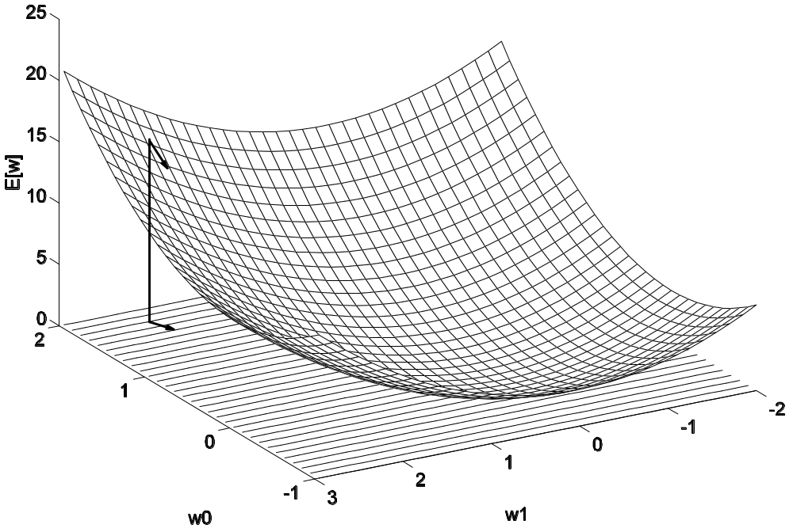



Gradient Descent
Greg Grudic
Intro AI

Slide 12
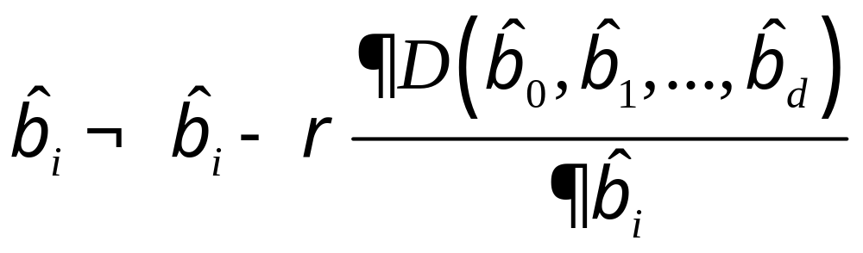
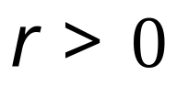
The Gradient Descent Algorithm
Where the learning rate is defined by:
Greg Grudic
Intro AI

Slide 13
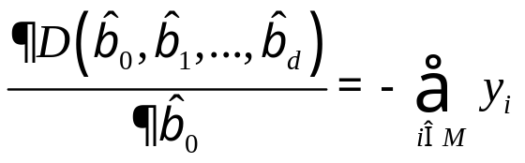
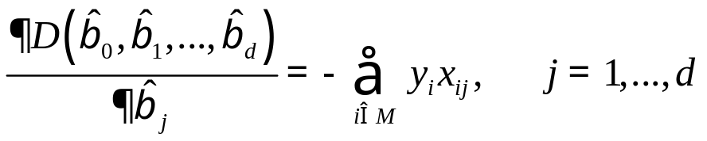
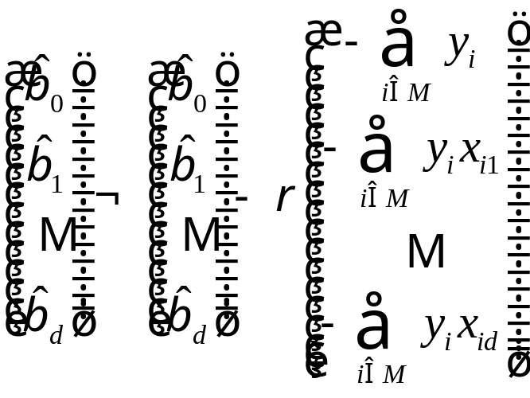
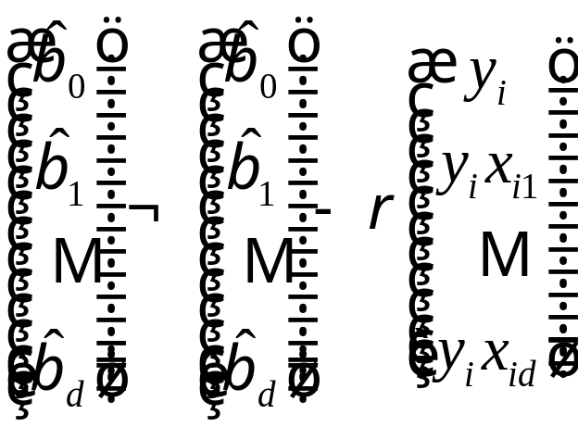
The Gradient Descent Algorithm for the Perceptron
Two Versions of the Perceptron Algorithm:
Update One misclassified
point at a time (online)
Update all misclassified
points at once (batch)
Greg Grudic
Intro AI

Slide 14
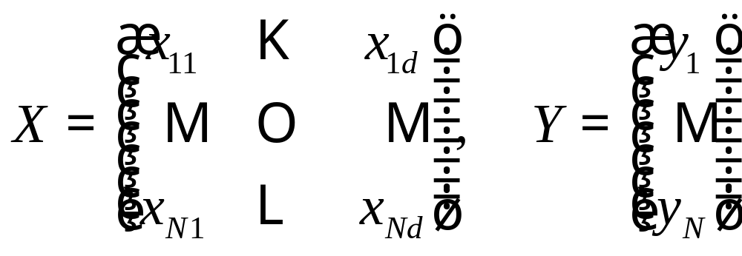
The Learning Data
Training Data:
Matrix Representation of N learning examples of d dimensional inputs
Greg Grudic
Intro AI

Slide 15
The Good Theoretical Properties of the Perceptron Algorithm
If a solution exists the algorithm will always converge in a finite number of steps!
Question: Does a solution always exist?
Greg Grudic
Intro AI

Slide 16
Linearly Separable Data
Which of these datasets are separable by a linear boundary?
+
-
+
+
-
-
+
+
-
-
-
a)
b)
Greg Grudic
Intro AI

Slide 17
Linearly Separable Data
Which of these datasets are separable by a linear boundary?
+
-
+
+
-
-
+
+
-
-
Not
Linearly
Separable!
-
a)
b)
Greg Grudic
Intro AI

Slide 18
Bad Theoretical Properties of the Perceptron Algorithm
If the data is not linearly separable, algorithm cycles forever!
  Cannot converge!
  This property “stopped” active research in this area between 1968 and 1984…
    Perceptrons, Minsky and Pappert, 1969
Even when the data is separable, there are infinitely many solutions
  Which solution is best?
When data is linearly separable, the number of steps to converge can be very large (depends on size of gap between classes)
Greg Grudic
Intro AI

Slide 19
What about Nonlinear Data?
Data that is not linearly separable is called nonlinear data
Nonlinear data can often be mapped into a nonlinear space where it is linearly separable
Greg Grudic
Intro AI

Slide 20
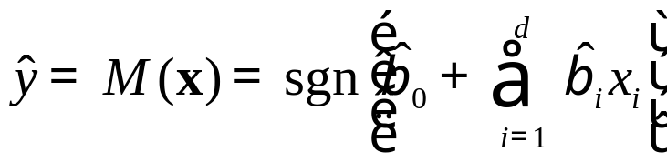
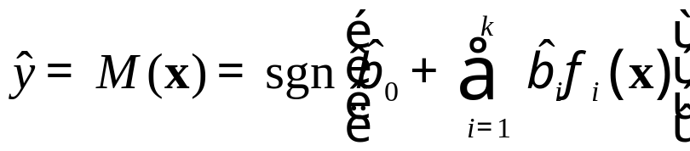
Nonlinear Models
The Linear Model:
The Nonlinear (basis function) Model:
Examples of Nonlinear Basis Functions:
Greg Grudic
Intro AI

Slide 21

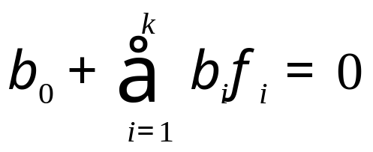

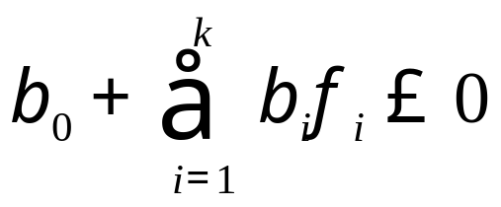

Linear Separating Hyper-Planes In Nonlinear Basis Function Space
Greg Grudic
Intro AI

Slide 22
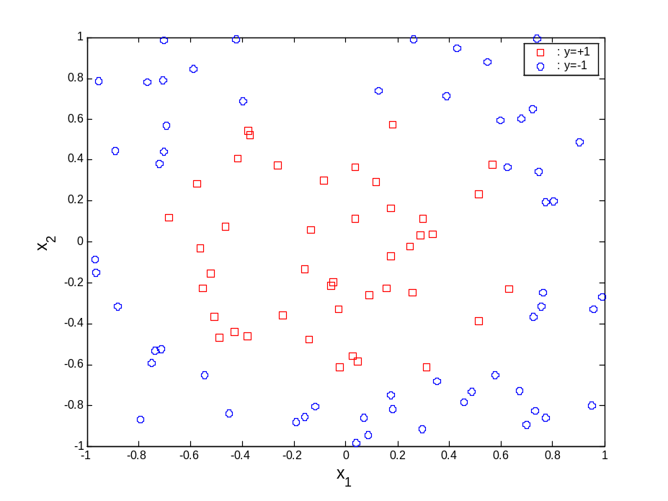

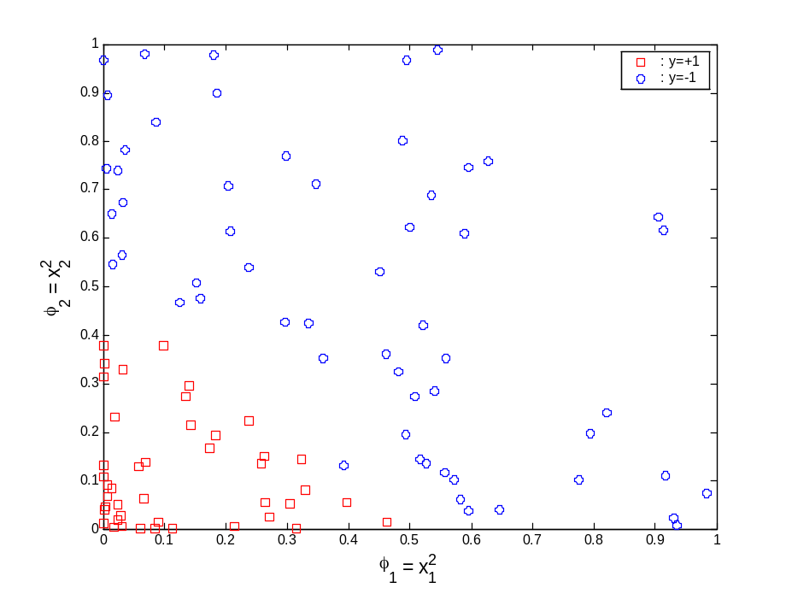
An Example
Greg Grudic
Intro AI

Slide 23
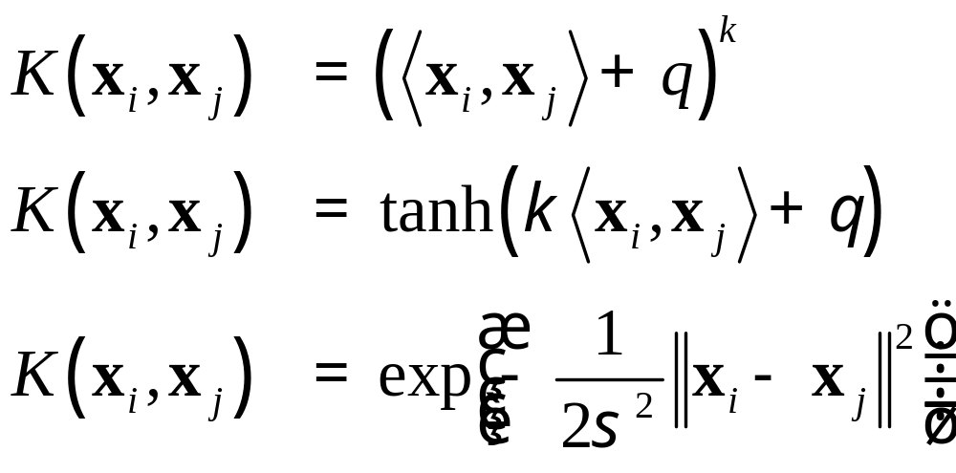
Kernels as Nonlinear Transformations
Polynomial
Sigmoid
Gaussian or Radial Basis Function (RBF)
Greg Grudic
Intro AI

Slide 24
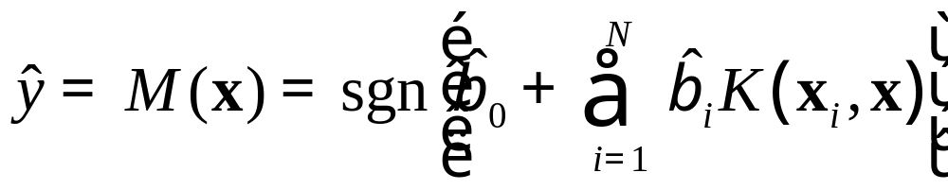
The Kernel Model
Training Data:
The number of basis functions equals
the number of training examples!
- Unless some of the beta’s get set to zero…
Greg Grudic
Intro AI

Slide 25
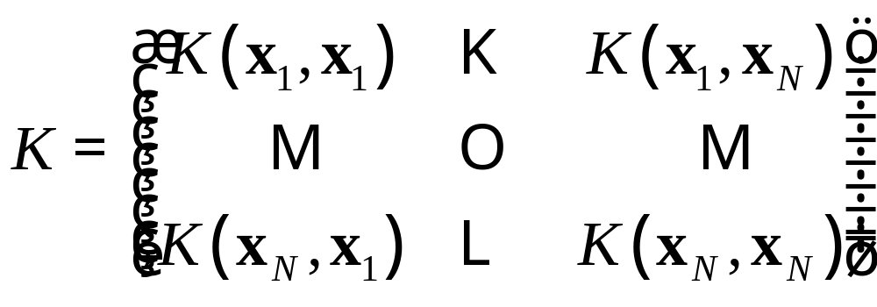
Gram (Kernel) Matrix
Training Data:
Properties:
      Positive Definite Matrix
        Symmetric
        Positive on diagonal
      N by N
Greg Grudic
Intro AI

Slide 26
Picking a Model Structure?
How do you pick the Kernels?
  Kernel parameters
These are called learning parameters or hyperparamters
  Two approaches choosing learning paramters
    Bayesian
      Learning parameters must maximize probability of correct classification on future data based on prior biases
    Frequentist
      Use the training data to learn the model parameters
      Use validation data to pick the best hyperparameters.
More on learning parameter selection later
Greg Grudic
Intro AI

Slide 27
Perceptron Algorithm Convergence
Two problems:
  No convergence when data is not separable in basis function space
  Gives infinitely many solutions when data is separable
Can we modify the algorithm to fix these problems?
Greg Grudic
Intro AI

